Slide 1
Moving Boat
Md. Shakil Mahmud
011 153 049
Md. Easin Arafat
011 152 047

Slide 2
Abstract
This synopsis contains implementation of ‘MOVING BOAT’ using a set of OpenGL functions.

Slide 3
Description
The project consists of dynamic background scenes. The scene shows the boat, which is moving. And the upper portion has clouds. Bunch of trees with a house. The objects are drawn using GLUT functions.

Slide 4
Features
The user can move the boat forward direction using alphabetical keys.
User can pause the ship.
User can stop the ship.

Slide 5
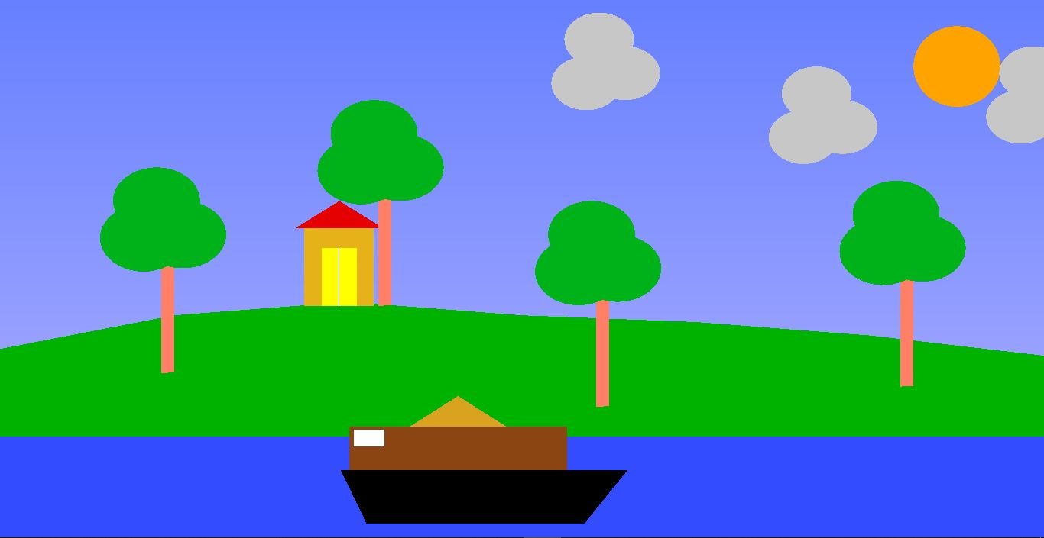
Snapshots

Slide 6
User Interaction
Using Alphabetical Keys:
‘B’: Move the Ship Forward
‘S’: Stop the Ship

Slide 7
Conclusion
We have attempted to design and implement “Moving Ship”. OpenGL supports enormous flexibility in the design and the use of OpenGL graphics programs. The presence of many built-in classes methods take care of much functionality and reduce the job of coding as well as makes the implementation simpler.

Slide 8
THANK YOU !! :)

